Slide 1

OBJECT ORIENTED PRINCIPLES USING JAVA
Title:
Stadium Seat Booking System
(Team no:07)
BY:
18K41A0539-NAHEER FATIMA
18K41A0550-SANA FARHEEN
18K41A0551- S.PRAVEEN kumar

Slide 2

CONTENTS:
Objectives
Elements used in the project
Screens
Test Cases
Test Results

Slide 3
OBJECTIVE:
It provides the searching facilities based on seats, show time, stadium names, show dates. The concept of files is there to store the information for the customer who reserved it. It provides efficiency and security .

Slide 4
ELEMENTS USED IN THE PROJECT:
Swings:
It is used to create window-based application and is built on the top of AWT (Abstract Windowing Toolkit) API (Application Programming Interface) and is entirely written in java. Java Swing provides platform-independent and lightweight components. The javax.swing package provides classes for java swing API such as JButton, JTextField, JTextArea, JRadioButton, JCheckbox, JMenu, JColorChooser etc.
Serialization in Java is a mechanism of writing state of object into byte stream. The reverse operation of serialization is called deserialization where byte-stream is converted into an object. The serialization and deserialization process is platform-independent.

Slide 5
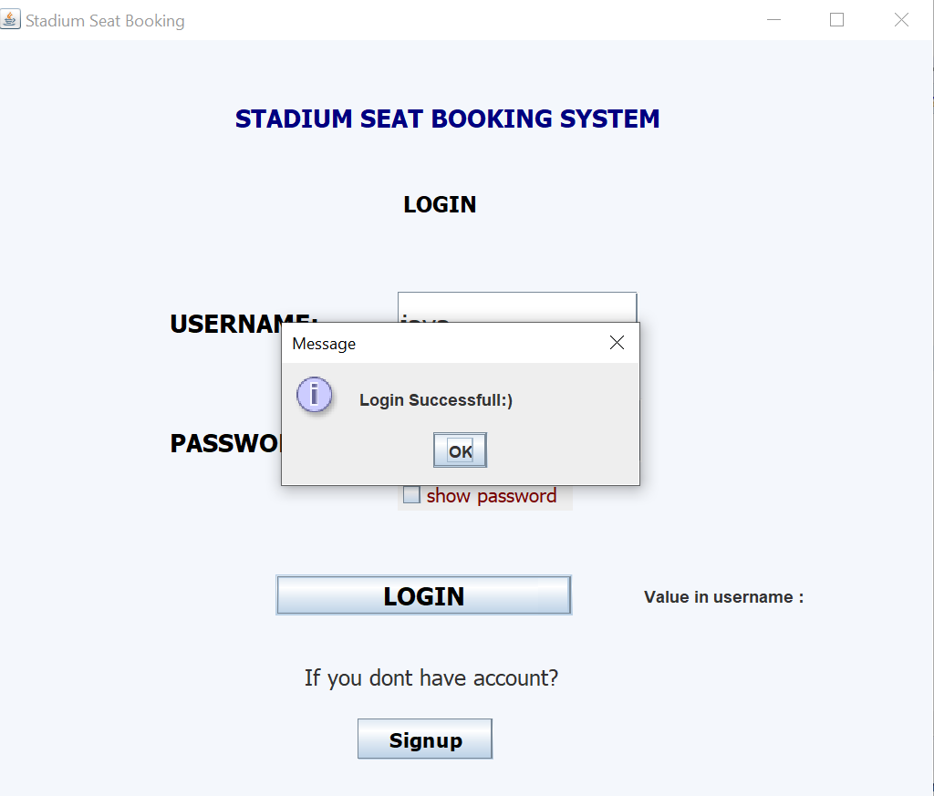
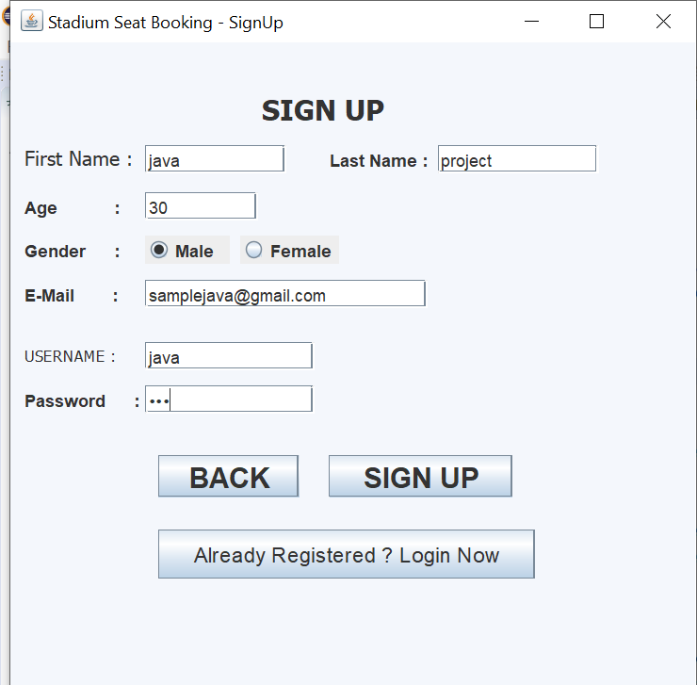
SCREENS:

Slide 6
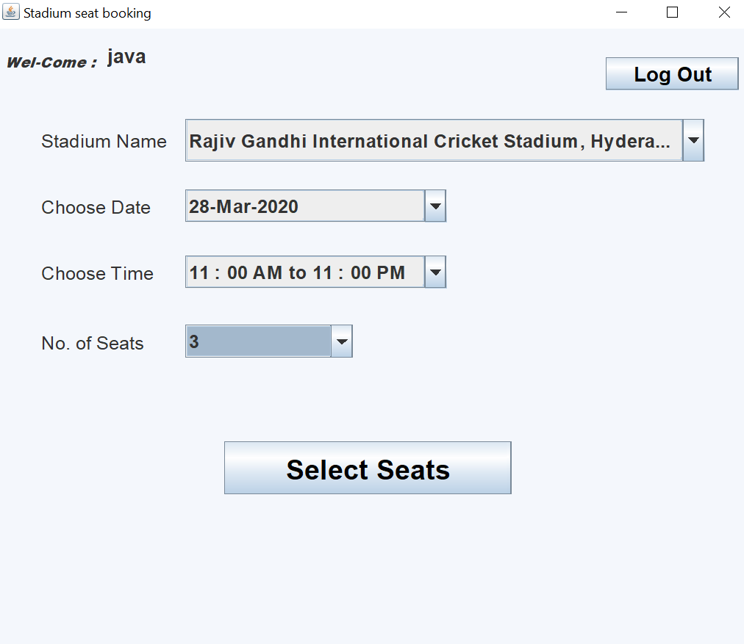
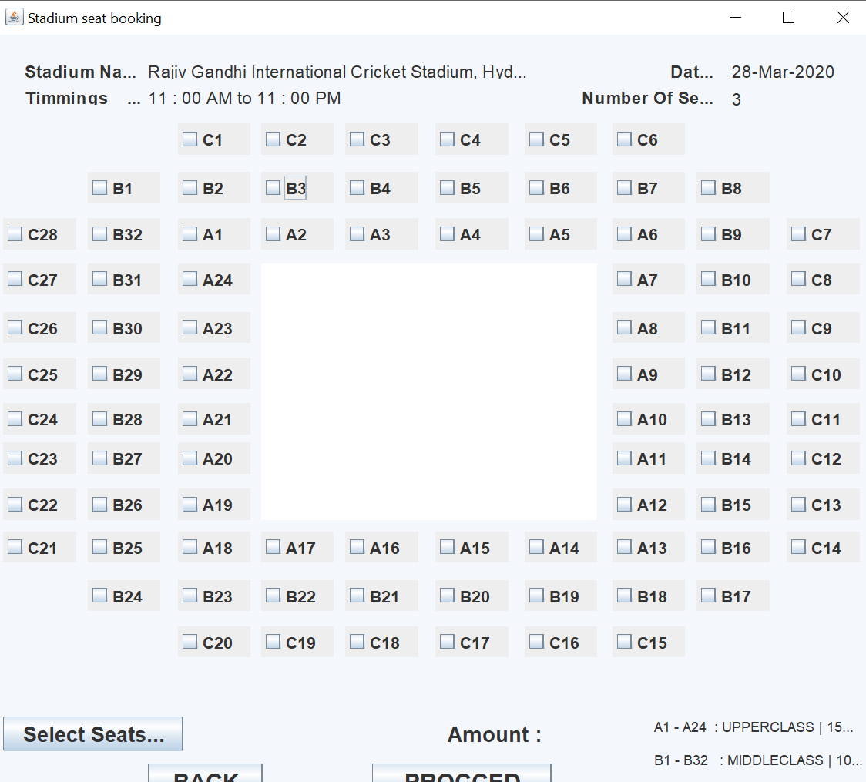
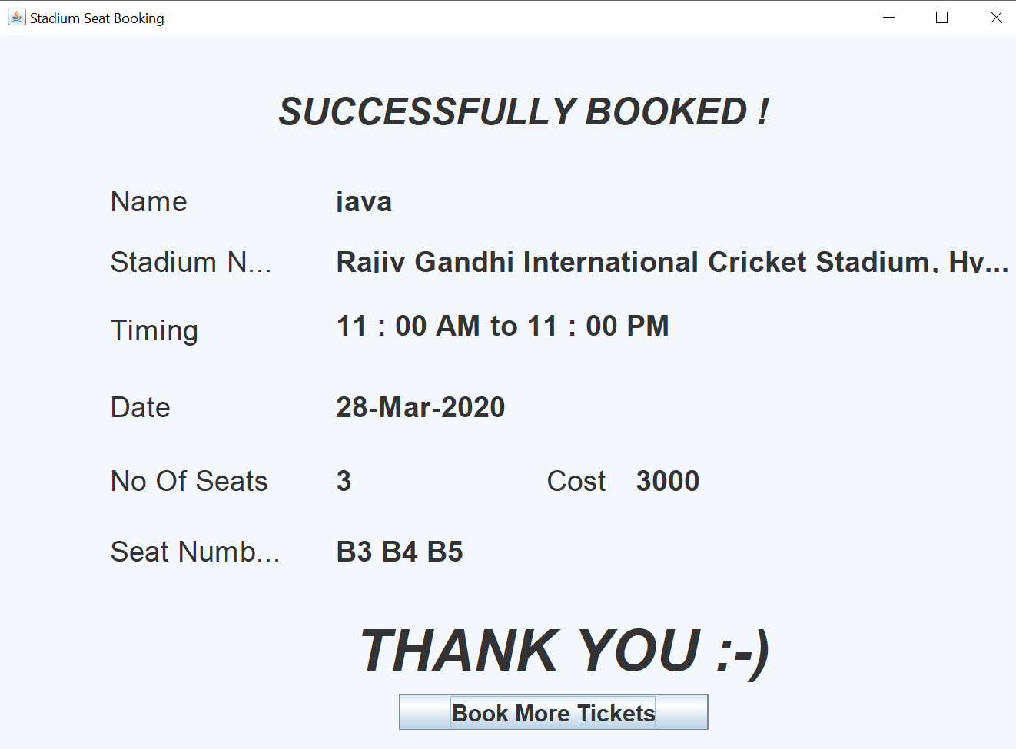

Slide 7
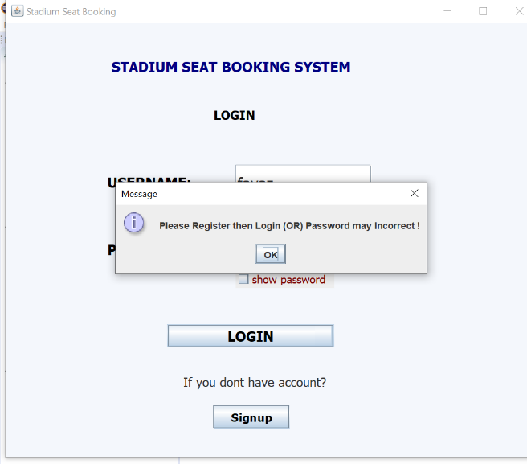
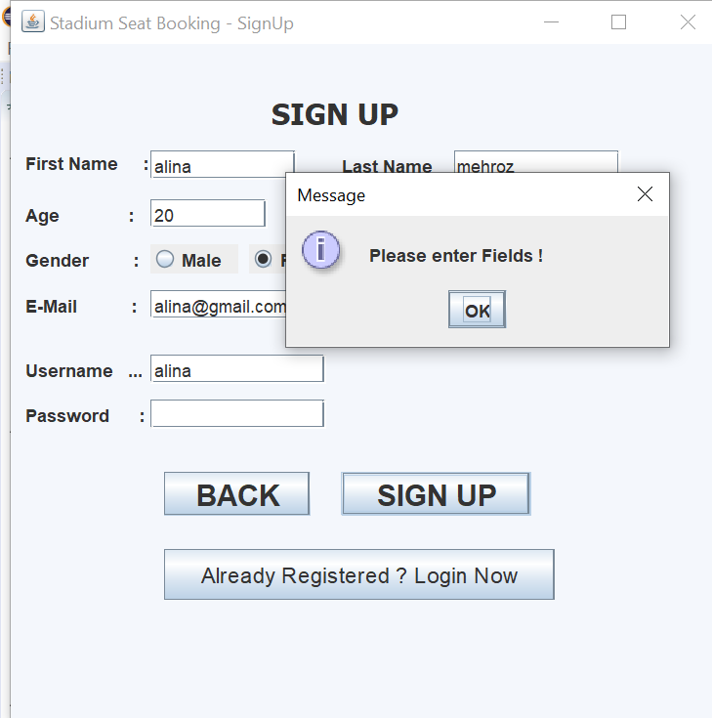
TEST CASES:
If new customers directly logins pop up displays first to register
If customer doesn’t register properly

Slide 8
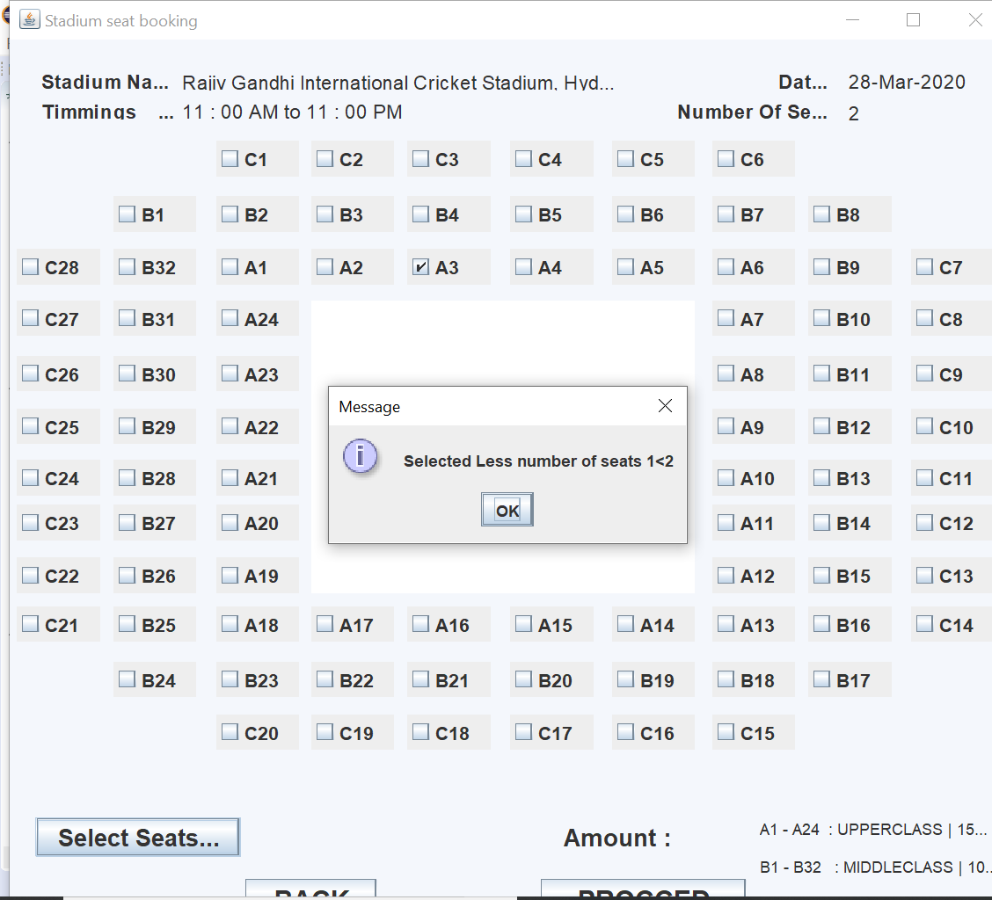
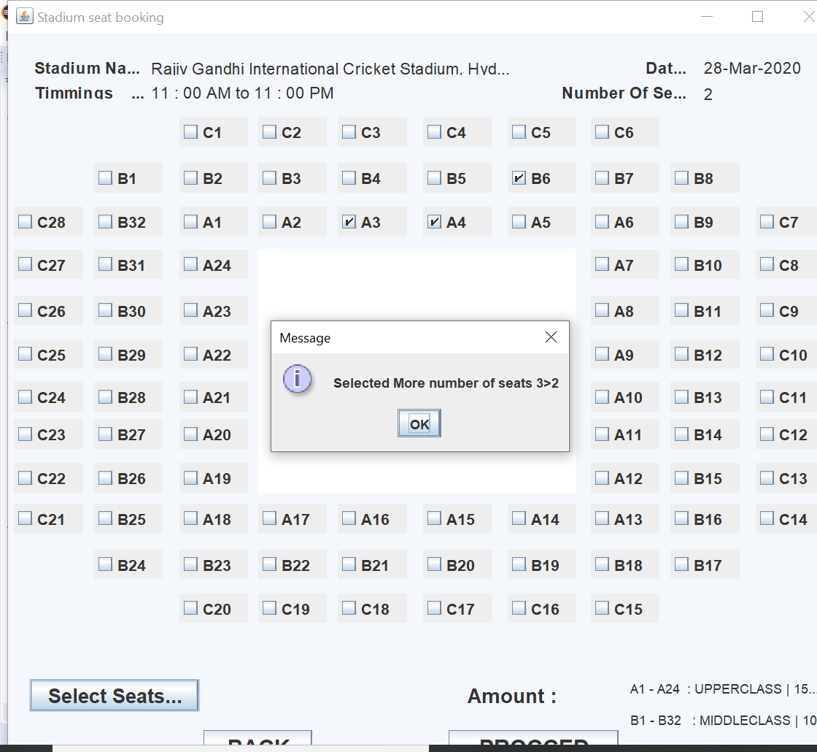
If customer selects more or less number of seats than required

Slide 9
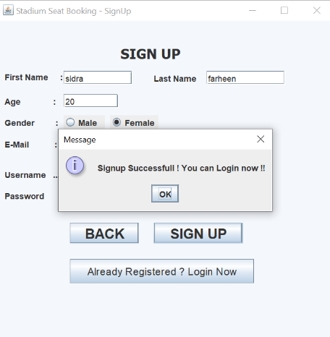
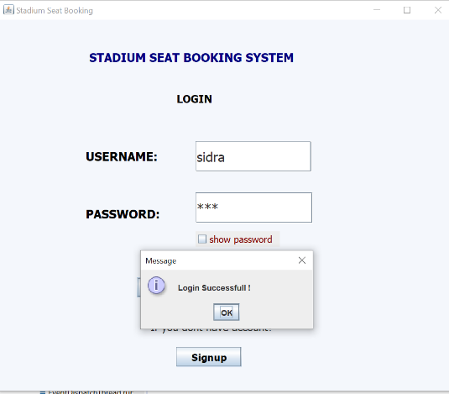
RESULTS:

Slide 10
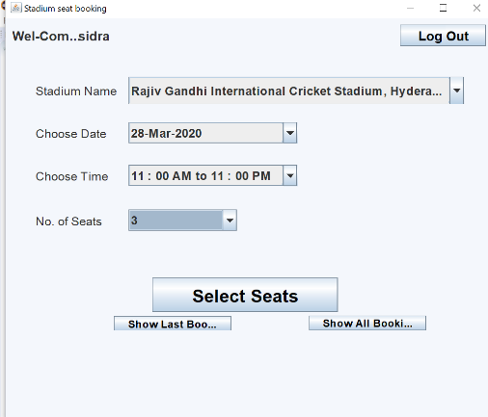
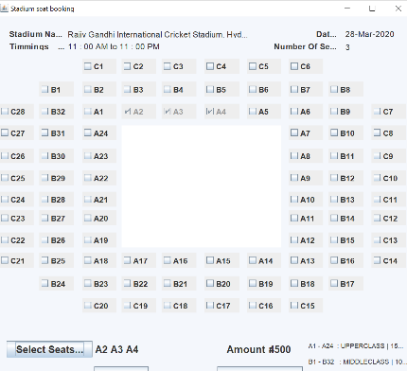
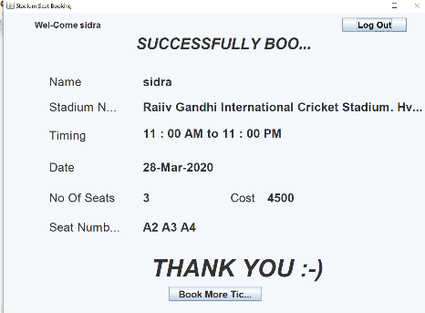

Slide 11

THANK YOU..!

